Slide 1
DATA ANALYSIS & VISUALIZATION
INSIGHTVISTA
2026
TEAM | 4 INSIGHTS
Enrollment numbers:
• 240840116005
• 240840116006
• 240840116034
• 240840116064
Data Set:- ORDER_DELIVERY

Slide 2
Observation & Raw Dataset
ROWS
COLUMNS
MISSING VALUES
DUPLICATE ROWS
5,589 order records
23 fields
0
0
Fields included
Raw data sample (first 3 records)
• Order details: Order_ID, User_ID, Item_Name, Quantity, Total_Price
• Timing and status: Order_Time, Delivery_Time, Delivery_Duration_Minutes, Order_Status
• Operations: City, Payment_Method, Driver_Vehicle, Traffic_Level
• Location: restaurant, customer and driver latitude/longitude
Order_ID | Item_Name | Quantity | Total_Price | City | Order_Status
1 | Fried Chicken | 3 | 273.72 | Alexandria | Delivered
2 | Sandwich | 3 | 365.82 | Zagazig | Delivered
3 | Koshary | 3 | 401.94 | Assiut | In Transit
Dataset overview: 7 cities, 9 item types, 3 payment methods and 3 order statuses.
02

Slide 3
Final Dataset: Preparation Steps & Reasons
01 Inspect schema
02 Validate completeness
Confirm 5,589 rows and 23 columns; verify field names and standardized data types.
Colab: df.shape; df.columns.tolist()
Check missing cells and exact duplicate rows before deciding whether to remove records.
Colab: df.isna().sum().sum(); df.duplicated().sum()
03 Standardize types
04 Validate business logic
Convert Order_Time and Delivery_Time to datetime; keep IDs as identifiers and numeric measures as numbers.
Colab: df["Order_Time"] = pd.to_datetime(df["Order_Time"])
Check positive quantities/prices/distances, valid status labels and delivery time consistency.
Colab: df = df[(df["Quantity"] > 0) & (df["Total_Price"] > 0)]
05 Add analysis fields
06 Load final table
Create order date, order hour, delivery duration bands and delivery success flag where useful.
Colab: df["Order_Hour"] = df.Order_Time.dt.hour
Keep a documented, reproducible clean table for Power BI visuals and measures.
Colab: df.to_csv("cleaned_orders.csv", index=False)
03

Slide 4
Clean Dataset Solution
QUALITY CHECKS
TRANSFORMATIONS
POWER BI MODEL
✓ 5,589 records retained
✓ 23 columns retained
✓ 0 null cells found
✓ 0 exact duplicate rows
• Verify standardized order/delivery timestamps
• Trim text spaces and standardize labels
• Confirm numeric data types
• Validate ranges and outliers
• Fact table: Orders
• Measures: Count of Order id , Sum of total price, avg of delevery_duration
• Dimensions: city, item, payment, status,Traffic_Level
• Date/time fields for trend analysis
Recommended final columns / derived fields
• Count of Order_ID by city
• Count of Order_ID by Order_Status
• Filter of Order_Status and City
• Sum of Total_price by Item_Name
04

Slide 5
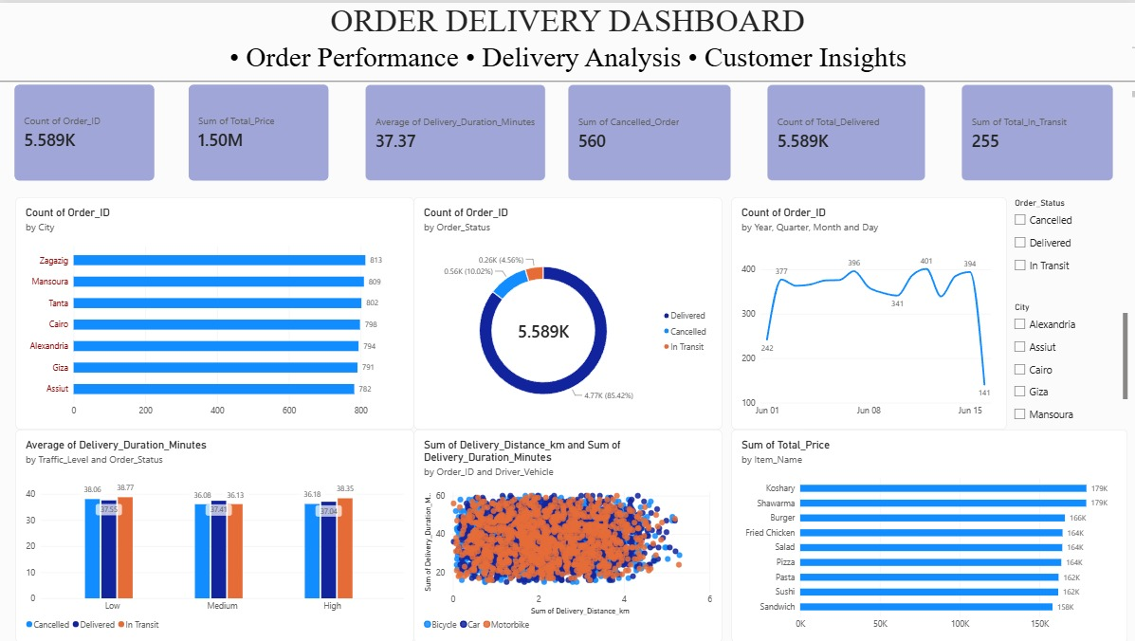
Visualization — Power BI Dashboard
Cluster chart
Donut chart
Line chart
Cluster bar chart
Scatter chart
Bar chart
05

Slide 6
Observations & Business Insights
TOTAL ORDERS
DELIVERED
CANCELLED
AVG DELIVERY
5,589
4,774 (85.4%)
560 (10.0%)
37.4 min
• Typical order value: 268.28 (dataset currency not specified); average quantity is 3.0 items.
• Average delivery distance is 2.19 km; use distance bands to compare time and order status.
• Zagazig has the highest order count (813); compare staffing and demand by city.
• Mansoura has the longest average delivery duration (38.1 minutes); investigate route, traffic and driver allocation.
• Koshary contributes the highest total sales value in this dataset; validate with a product revenue visual.
06

Slide 7
Business Recommendations & Industrial Use
FOR FOOD DELIVERY BUSINESSES
FOR OPERATIONS & LOGISTICS
• Forecast demand by city, item and hour
• Schedule more drivers during demand peaks
• Monitor cancellation rate and delivery SLA
• Compare delivery time by distance and vehicle
• Optimize delivery zones and route assignment
• Track driver availability and utilization
• Use alerts for unusually long deliveries
• Compare actual performance with use of KPIs
INDUSTRIAL APPLICATIONS
NEXT STEPS / KPIs
• Last-mile logistics and courier services
• Retail/e-commerce order fulfilment
• Restaurant chains and cloud kitchens
• Fleet management and urban planning
• Set target: delivery time and cancellation rate
• Test changes city-by-city before scaling
• Review weekly trends, not one-day results
• Track revenue, on-time rate and cost per order
07

Slide 8
THANK YOU
4 INSIGHTS | INSIGHTVISTA 2026
From raw data to clearer decisions.
Questions & Discussion
Data Analysis and Visualization

